Slide 1

Dr. D. Y. Patil Institute of Technology
Pimpri, Pune 411018
BE computer engineering project on :
“Multiple disease detector system Using Machine Learning & Deep Learning Techniques”
Group Members:
1 Amar bhade
2. Pankaj phulera
3 Divyaamshu Verma
4 Vijay Aglawe
Guide :
Prof. Rupesh Mahajan

Slide 2
CONTENTS:
Introduction
Motivation Problem Statement
Objectives
Literature Survey
Proposed Methodology
Algorithms Used(Features)
Software/Hardware Requirements
Architecture Diagram
Results
Future improvements
Challenges
Conclusion
References

Slide 3
Introduction:
Machine learning and Artificial Intelligence are playing a huge role in today’s world. From self-driving cars to medical fields, we can find them everywhere. The medical industry generates a huge amount of patient data which can be processed in a lot of ways. So, with the help of machine learning, we have created a Prediction System that can detect more than one disease at a time. Many of the existing systems can predict only one disease at a time and that too with lower accuracy. Lower accuracy can seriously put a patient’s health in danger. We have considered four diseases for now that are Kidney, Thyroid, Covid and Cancer and in the future, many more diseases can be added. The user has to enter various parameters of the disease and the system would display the output whether he/she has the disease or not. This project can help a lot of people as one can monitor the persons’ condition and take the necessary precautions thus increasing the life expectancy.
Key Words: Kidney, Covid , Cancer, XgBoost , Random forest, CNN, Thyroid.

Slide 4
Problem Statement:
Multiple disease detector system Using Machine Learning & Deep Learning

Slide 5
Objective: :
The aim of this study is to develop and test a reliable diagnostic tool, using deep learning technology to detect COVID-19 ,Cancer disease, Kidney chronic disease which features from chest X-rays and medical data . This tool would accelerate the diagnosis and referral of patients, improving clinical outcomes.
Releasing the deep learning model as open source would facilitate the use of the tool both now and in any future pandemics, where a similar algorithm could be used. Also we used the Xgboost, Random Forest ,CNN layers.
This particular application also has the potential to be scaled up and used for more generalized high-impact applications in biomedical imaging.

Slide 6
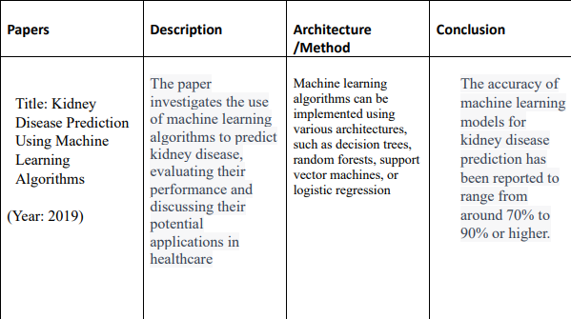
LITERATURE SURVEY:

Slide 7
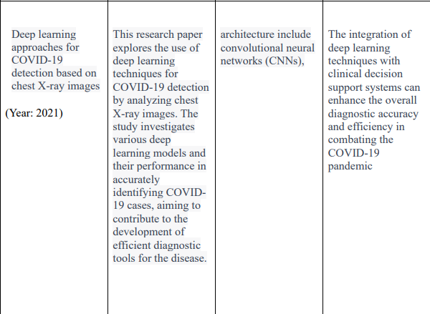
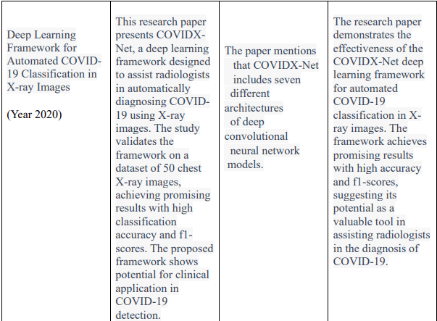

Slide 8
METHODOLOGY:
Knn Algorithm
The working of the K-NN algorithm is as followed:
• Step-1: Start to select the K value for example k=5
• Step-2: Then we will find the Euclidean distance between the points.
Euclidean Distance - √(█((x2-x1)^2+(y2-y1)^2))
• Step-3: Then we will calculate the Euclidean distance of the nearest neighbour.
• Step-4: Then count the number of the data points in each category .For example found three values for Category A and two values for category B.
• Step-5: Then assign the new point to the category having maximum number of neighbours. For example Category A has highest number of neighbour so we will assign the new data point to category A.
• Step-6: So finally our Knn model is ready.
Random Forest Algorithm
Random Forest working is possible in two phases , first is to create the random forest by merging N decision tree, and second is making prediction for each tree created in the first phase. The working of the random forest is as follows:
Step-1: Firstly it will select random K data points from the training set.
Step-2: After selecting k data points then building the decision trees associated with the selected data points (Subsets).
Step-3: Then choosing the number N for decision trees that you want to build.
Step-4:Repeating step 1 and 2 .
Step-5: Finding the predictions of each decision tree, and assigning the new data points to the category that wins the majority votes.

Slide 9
XGBoost Algorithm
The working of XGBoost algorithm are as follows:
Step 1: Firstly creating a single leaf tree.
Step 2: Then for the first tree, we have to compute the average of target variable as prediction and then calculating the residuals using the desired loss function and then for subsequent trees the residuals come from prediction that was there in previous tree.
Step 3: Calculating the similarity score using formula: where, Hessian is equal to number of residuals; Gradient2 = squared sum of residuals; λ is a regularization hyperparameter.
Step 4: Applying similarity score we select the appropriate node. The higher the similarity score more the homogeneity.
Step 5: Applying similarity score we calculate Information gain. Information gain help to find the difference between old similarity and new similarity and tells how much homogeneity is achieved by splitting the node at a given point.
Step 6:Creating the tree of desired length using the above method pruning and regularization can be done by playing with the regularization hyperparameter.
Step 7: Then we can predict the residual values using the Decision Tree you constructed.
Step 8: The new set of residuals is calculated as: where ρ is the learning rate.
Step 9:Then go back to step 1 and repeat the process for all

Slide 10
CNN Algorithm
Data Collection and Preprocessing:
  Collect a dataset of chest X-ray or CT scan images including COVID-19 positive cases and non-COVID-19 cases.
  Preprocess the images by resizing them to a consistent resolution, normalizing pixel values, and applying data augmentation techniques like rotation, scaling, and flipping.
Dataset Split:
  Split the preprocessed dataset into three subsets: training set, validation set, and test set.
  The training set is used to train the CNN model, the validation set is used for hyperparameter tuning and model evaluation during training, and the test set is used for final evaluation.
Model Architecture:
  Design the CNN model architecture.
  Select the number and types of layers, including convolutional layers, pooling layers, and fully connected layers.
  Choose appropriate activation functions and regularization techniques (e.g., dropout) to prevent overfitting.
  Define the model's parameters, such as filter sizes, strides, and number of filters in each layer.
Model Compilation:
  Compile the CNN model by specifying the loss function, optimization algorithm, and evaluation metrics.
  Common choices for the loss function include binary cross-entropy for binary classification (COVID-19 vs. non-COVID-19) or categorical cross-entropy for multi-class classification (COVID-19 vs. other lung diseases).
  Popular optimization algorithms include Adam, RMSprop, or Stochastic Gradient Descent (SGD).
Model Training:
  Train the CNN model using the training set.
  During training, input the preprocessed images into the model, calculate the loss based on predicted outputs, and update the model's weights using backpropagation and gradient descent.
  Iterate through multiple epochs, adjusting the model's parameters to minimize the loss and improve accuracy.
  Monitor the model's performance on the validation set to prevent overfitting and adjust hyperparameters accordingly.

Slide 11
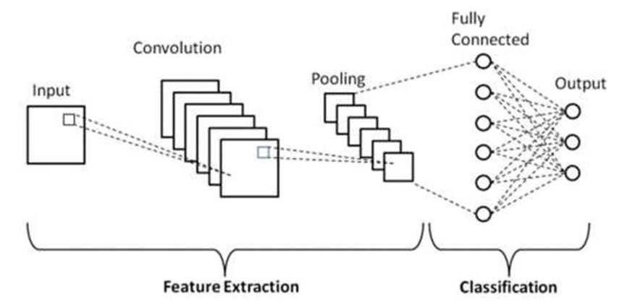
7.Model Evaluation:
  Evaluate the trained model on the test set to assess its performance.
  Calculate metrics such as accuracy, precision, recall, and F1 score to measure the model's effectiveness in detecting COVID-19.
  Analyze any false positives or false negatives to understand the model's limitations and potential areas for improvement.
8.Model Deployment:
  Once the model has demonstrated good performance, it can be deployed to a production environment.
  Prepare the model for deployment by converting it into a format suitable for deployment frameworks or libraries.
  Integrate the model into an application or system that can accept new chest X-ray or CT scan images and make predictions on their COVID-19 status.

Slide 12
Algorithms Used(Features):
Machine learning Algorithms.
Deep learning models.
K nearest Neighbors.
Convolutional Neural Network.
XgBoost Algorithm.
Random Forest.

Slide 13
Software Requirements:
Coding Language : python
Technologies: Machine learning, Deep learning
Operating System : Windows 11
Frontend : HTML, CSS, JSP, REACT JS
Backend : python
Frameworks: Flask.
DATABASE : Mongo DB

Slide 14
Hardware Requirements:
Processor : Core-i5
Speed : 2.3 GHz
GPU support.
Ram : 8 GB
Hard Disk : 128 GB
Keyboard : Standard Windows Keyboard
Mouse : Two or Three button mouse
Monitor : LCD/LED

Slide 15
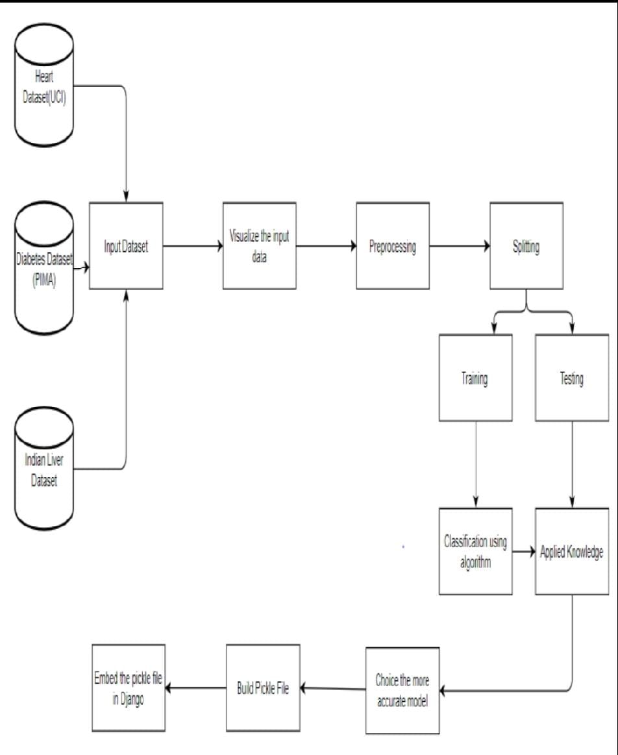
Architecture Diagram:

Slide 16
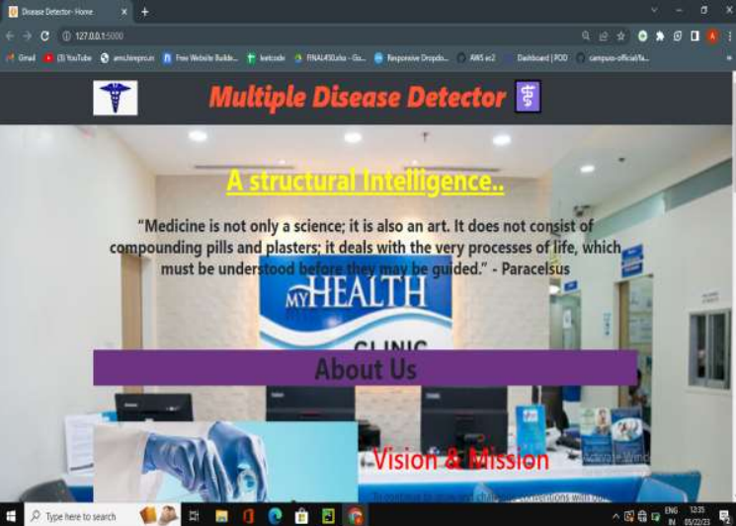

RESULTS: (HOMEPAGE)

Slide 17
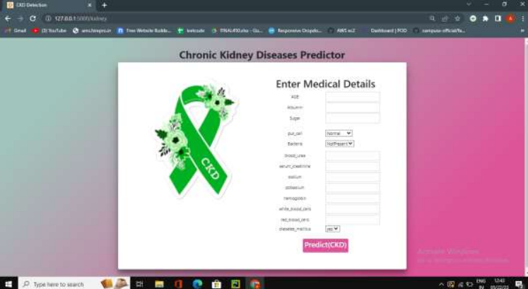
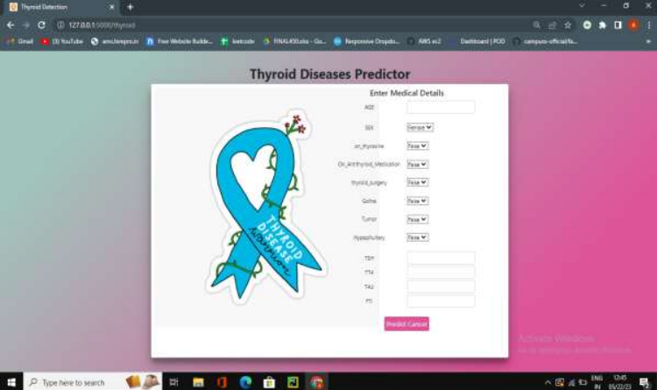
TEST PAGE:

Slide 18
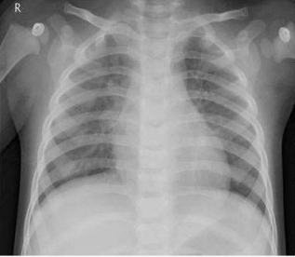
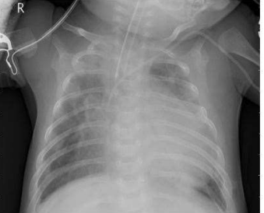
SAMPLE TEST:

Slide 19
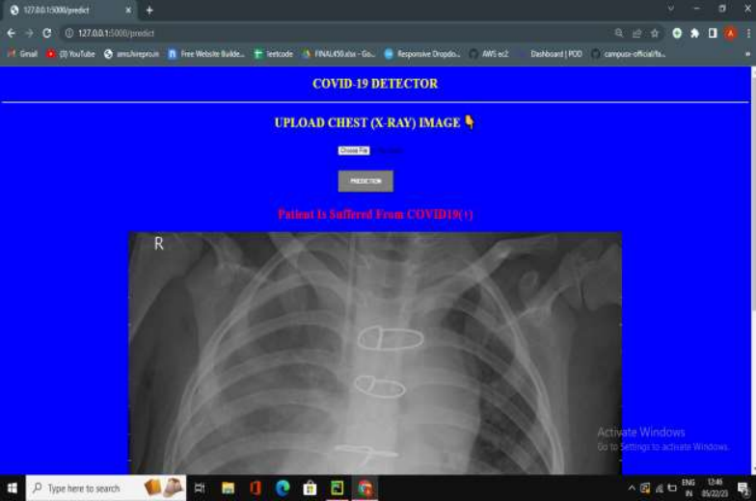
TEST RESULT:

Slide 20
Challenges:
Image preprocessing.
Scalability problems.
Data collection.
Data Preprocessing .
Improveing efficiency.
Optimizing solution.
Lack of Domain Knowledge.

Slide 21
Conclusion:
The main objective of this project was to create a system that would predict more than one disease and do so with high accuracy. Because of this project the user doesn’t need to traverse different websites which saves time as well. Diseases if predicted early can increase your life expectancy as well as save you from financial troubles. For this purpose, we have used various machine learning algorithms like Random Forest, XGBoost, and K nearest neighbor (KNN) ,CNN Architecture to achieve maximum accuracy.

Slide 22
Further Improvements 📈:
This was my first big project so there are lot of things to improve upon
CSS code is totally messed up (some code in file and some inline)
Frontend can be made more nicer (PS: I suck at frontend development)
More data can be collected manually via web scrapping to make the system more accurate
Modularized code can be written instead of writing in Jupyter Notebooks (will follow this in upcoming projects)

Slide 23
Future Scope:
In the future we can add more diseases in the existing API.
We can try to improve the accuracy of prediction in order to decrease the mortality rate.
Try to make the system user-friendly and provide a chatbot for normal queries.

Slide 24
RefErences:
[1] Priyanka Sonar, Prof. K. JayaMalini,” Cancer PREDICTION USING DIFFERENT MACHINE LEARNING APPROACHES”, 2019 IEEE ,3rd International Conference on Computing Methodologies and Communication (ICCMC)
[2] Archana Singh ,Rakesh Kumar, “Kidney Disease Prediction Using MachinLearning Algorithms”, 2020 IEEE, International Conference on Electrical and Electronics Engineering (ICE3).
[3] A.Sivasangari, Baddigam Jaya Krishna Reddy,Annamareddy Kiran, P.Ajitha,” Diagnosis of Liver Disease using Machine Learning Models” 2020 Fourth International Conference on I-SMAC (IoT in Social, Mobile, Analytics and Cloud) (I-SMAC)

Slide 25
[4] A. M. Ismael and A. Şengür, “Deep learning approaches for COVID-19 detection based on chest X-ray images,” Expert Systems with Applications, vol. 164, Article ID 114054, 2021.
[7] E. E.-D. Hemdan, M. A. Shouman, and M. E. J. A. P. A. Karar, Covidx-Net: A Framework of Deep Learning Classifiers to Diagnose Covid-19 in X-Ray Images, MedRxiv, Cold Spring, NY, USA, 2020.
[5] K. Sahinbas and F. O. Catak, “Transfer learning-based convolutional neural network for COVID-19 detection with X-ray images,” in Data Science for COVID-19, Elsevier, Amsterdam, Netherland, 2021.
[6] A. K. Das, “Automatic COVID-19 detection from X-ray images using ensemble learning with convolutional neural network,” Pattern Analysis and Applications, vol. 24, pp. 1–14, 2021.
[7] A. K. Jaiswal, P. Tiwari, V. K. Rathi, J. Qian, H. M. Pandey, and V. H. C. J. M. Albuquerque, Covidpen: A Novel Covid-19 Detection Model Using Chest X-Rays and Ct Scans, MedRxiv, Cold Spring, NY, USA, 2020.

Slide 26


